Slide 1


HOME AUTOMATION Using MESH TOPOLOGY
Presenting by
B Sai Abhishek BL.EN.U4AIE21015
B Ruchith Balaji BL.EN.U4AIE21017
Chillakuru Hari BL.EN.U4AIE21038
21AIE203- Data Structures and Algorithms-2

Slide 2
Contents:
Main Objective.
Introduction.
Implementation
Code
Output
Conclusion

Slide 3
Main Objective:
To implement Home Automation with mesh topology.
To control the devices
To change the state of devices

Slide 4
Introduction:
Home Automation
Home automation refers to the use of technology to control and automate various systems and appliances in a home.
This can include things like lighting, heating and cooling, security systems, and home entertainment systems

Slide 5
Introduction:
Applications
Lighting Control.
Heating and Cooling.
Home Security.

Slide 6
Introduction:
Devices that we are using in this Implementation:
1) Hall Sensor
2) Kitchen Sensor
3) Bedroom Sensor
4) Hall Bar Light
5) Hall Tv
6) Kitchen Bulb
7) Kitchen Exhaust Fan
8) Bed Room TV
9) Bed Room Light
10) Bed Room AC

Slide 7
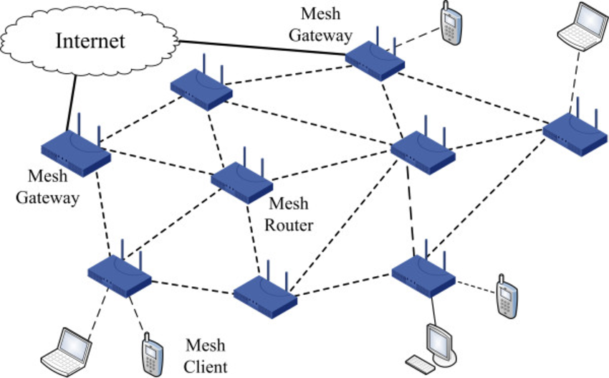
Mesh Topology:
What is Mesh Topology?
It is a net work in which infrastructure nodes connect directly to other nodes.
Networks consists of 3 parts…
Gate way
Router
Client

Slide 8
Mesh Topology:
Mesh Topology Functions
Flooding.
Routing.
Types of Mesh Topologies
Full Mesh Topology.
Partial Mesh Topology.

Slide 9
Mesh Topology:
Application
Home Automation...
Military Organization.
Emergency services.
Advantages:
Consistent data transmission.

Slide 10
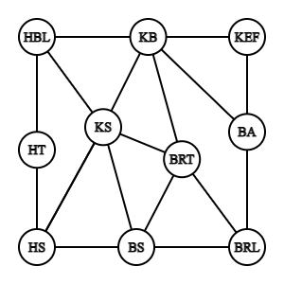
Implementation:

Slide 11
Code :

Slide 12
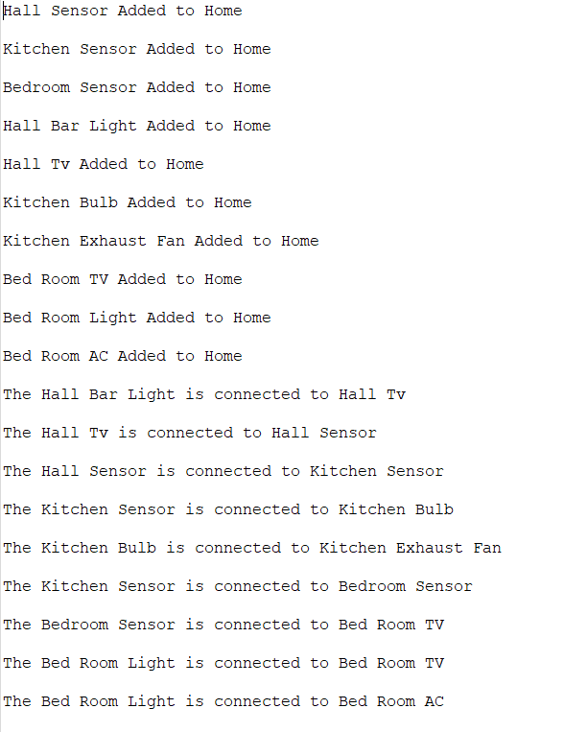
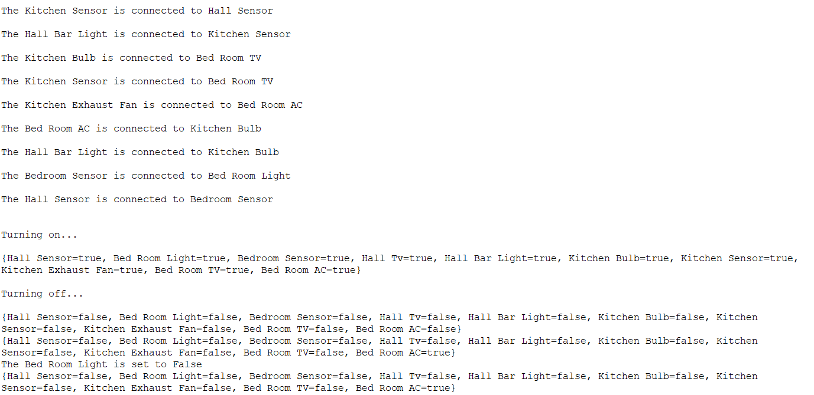
Output :

Slide 13
Conclusion:
Implemented Home Automation using Mesh Automation

